Slide 1


ERP
The Implementation of ERP Systems

Slide 2
OUTLINE
ERP Implementation
ERP Success Factors
ERP Failure Factors

Slide 3
Learning Objectives
01
02
03
Explain the ERP success factors
Explain the ERP failure factors
Describe the implementation lifecyle of ERP

Slide 4
Recap

Slide 5

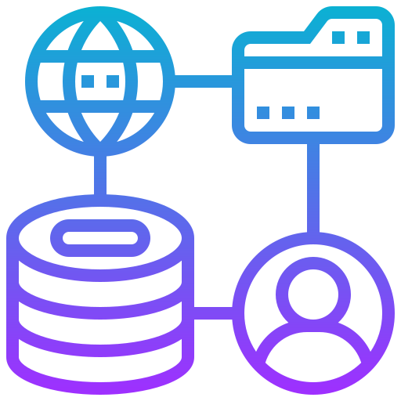
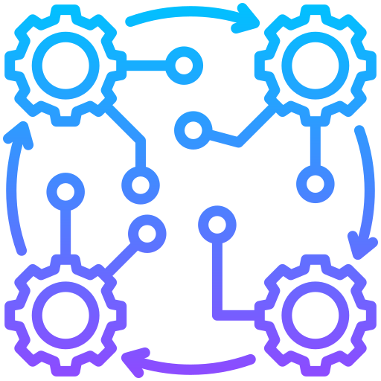
Enterprise Resource Planning (ERP)
Enterprise Resource Planning (ERP) programs are software used by companies to manage information in every area of the business.​
ERP programs help manage company-wide business processes using a common database and shared management reporting tools.​
ERP software supports the efficient operation of business processes by integrating activities throughout a business.

Slide 6
Business Function vs Business Process
Aspect | Business Function | Business Process
Focus | Department or role | Workflow or activity flow
Boundaries | Usually stays within one department | Often spans multiple departments
Goal | Performs specialized tasks | Achieves a business outcome
Example | HR department managing employee records | Onboarding a new employee (HR + IT + Payroll)

Slide 7
ERP Implementation

Slide 8
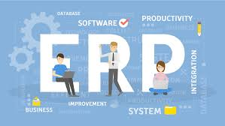
What is ERP Implementation?
ERP implementation is the process of planning, configuring, and deploying an Enterprise Resource Planning (ERP) system to integrate core business processes such as finance, human resources, procurement, inventory, and production into a unified software platform.

Slide 9
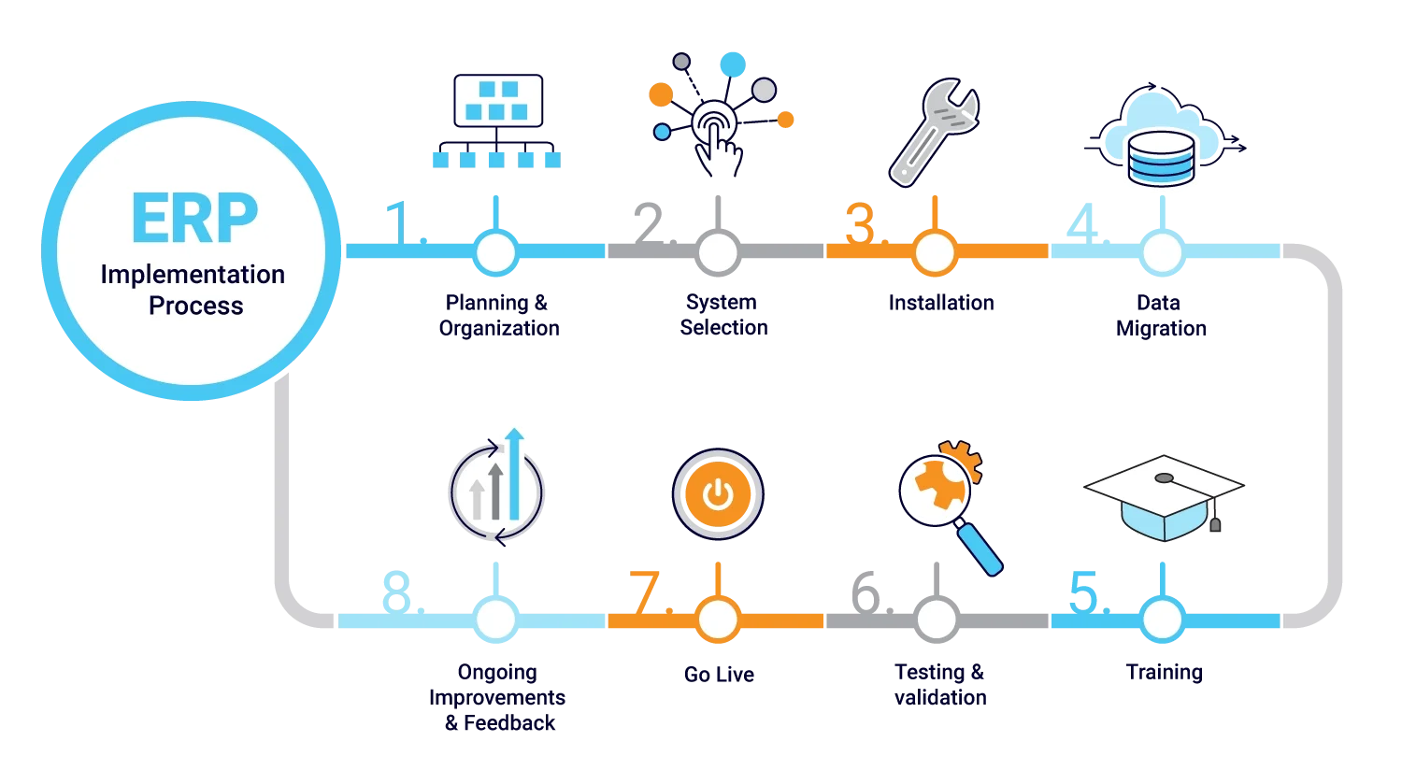
What is ERP Implementation Process?

Slide 10
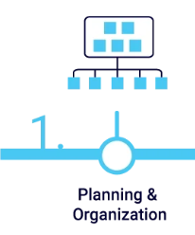
ERP Implementation
STEP 1 : Planning & Organization
Objective: Set goals, form a project team, and prepare a strategy.
Sub-steps:
Identify business problems and needs
Define project scope and timeline
Assign roles (project manager, team leads)
Outcome: A clear ERP implementation plan with defined responsibilities and timeline.

Slide 11
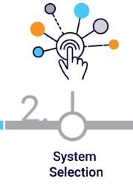
ERP Implementation
STEP 2 : System Selection
Objective: Choose the right ERP system that fits the company’s needs.
Sub-steps:
List required features (finance, HR, inventory, etc.)
Compare ERP vendors (SAP, Oracle, Odoo)
Get feedback from departments
Outcome: ERP software selected that meets business requirements.

Slide 12
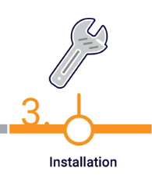
ERP Implementation
STEP 3 : Installation
Objective: Set up the ERP software on servers or cloud.
Sub-steps:
Install ERP on company servers or subscribe to cloud ERP
Set up user access and permissions
Outcome: ERP system is technically ready for configuration and use.

Slide 13
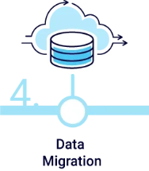
ERP Implementation
STEP 4 : Data Migration
Objective: Transfer existing business data (like customer lists, invoices) into the ERP system.
Sub-steps:
Clean old data (remove duplicates/errors)
Map old data to new ERP fields
Test the migrated data
Outcome: Accurate business data is loaded into the ERP system.

Slide 14
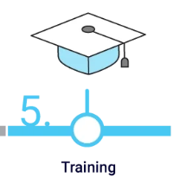
ERP Implementation
STEP 5 : Training
Objective: Teach users how to use the new ERP system.
Sub-steps:
Prepare training materials
Conduct workshops or hands-on training
Provide user manuals
Outcome: Staff are confident and capable of using the ERP system.

Slide 15

ERP Implementation
STEP 6 : Testing & Validation
Objective: Ensure the system works correctly before going live.
Sub-steps:
Run test scenarios (purchase order, salary processing)
Identify bugs or errors
Fix and re-test
Outcome: Verified and reliable ERP system ready for use.

Slide 16

ERP Implementation
STEP 7 : Go Live
Objective: Launch the ERP system in the real business environment.
There are three main options.
Big Bang: The new ERP system is activated and used exclusively going forward.
Phased: The new ERP system is activated in phases to minimize disruptions in operations.
Parallel: Both the legacy system and the new ERP system run at the same time.
Sub-steps:
Switch from old system to ERP
Monitor real transactions
Offer quick user support
Outcome: ERP system is now in active use.

Slide 17
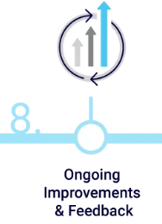
ERP Implementation
STEP 8 : Ongoing Improvements & Feedback
Objective: Improve the system based on user experience.
Sub-steps:
Gather feedback from users
Identify new requirements or issues
Apply updates or enhancements
Outcome: ERP system becomes more efficient and aligned with changing business needs.

Slide 18
ERP Success Factors

Slide 19
ERP Success Factors
Clear Objectives and Goals:
Clearly define what the organization aims to achieve with the ERP implementation.
Strong Leadership and Project Management:
Appoint experienced project managers and leaders to oversee the implementation.
Effective Change Management:
Develop a comprehensive change management plan to support employees through the transition.
Engagement and Training:
Invest in thorough training programs to ensure users are comfortable with the new system..

Slide 20
ERP Success Factors
Data Migration Strategy:
Plan and execute a meticulous data migration strategy to maintain data integrity.
Regular Monitoring and Evaluation:
Continuously monitor project progress and adjust strategies as needed.
Vendor Collaboration:
Foster a collaborative relationship with the ERP vendor for ongoing support and updates.
Scalability and Future-proofing:
Ensure the ERP system is scalable and adaptable to future business needs.

Slide 21
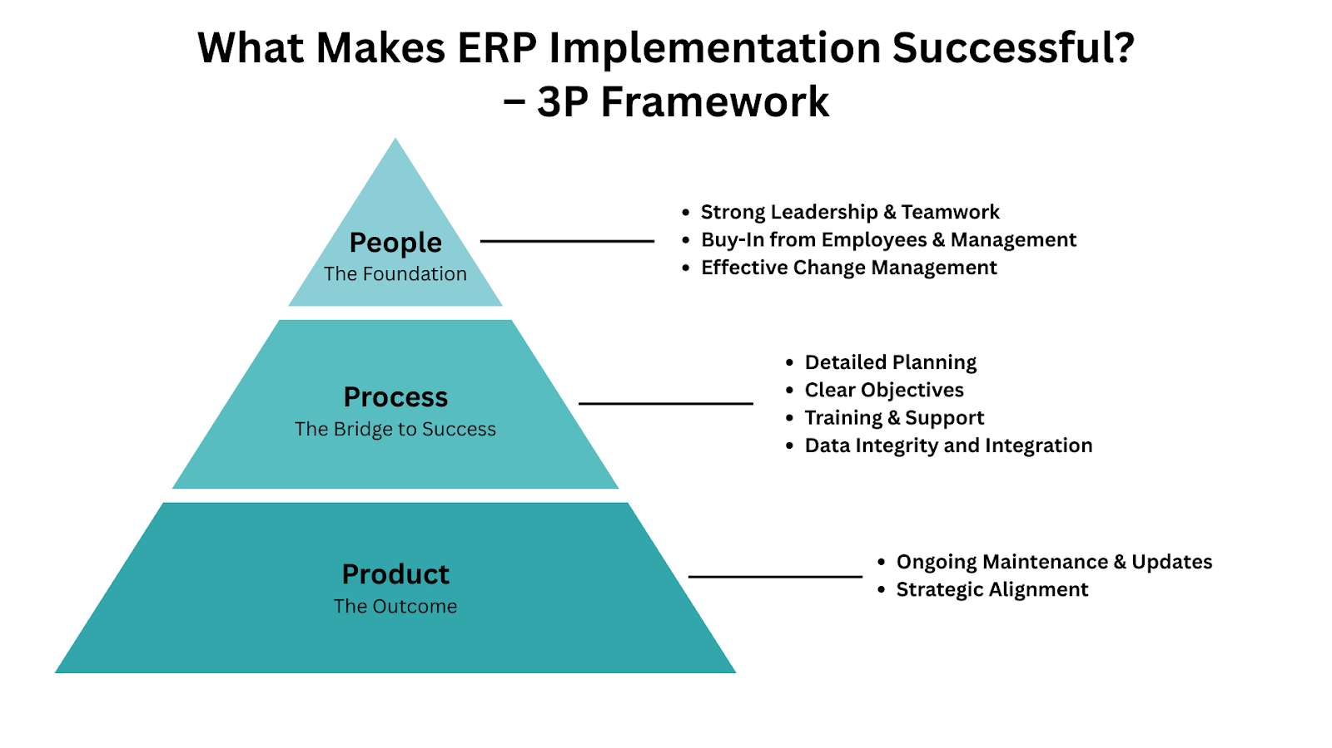

Slide 22
ERP Implementation KPIs
Timeline Adherence:
KPI: Project milestones achieved within the planned timeline.
Why it matters: Delays can lead to increased costs and disrupt business operations.
Budget Adherence:
KPI: Staying within the approved budget for the ERP implementation project.
Why it matters: Cost overruns can severely impact the return on investment (ROI) of the ERP system.
User Adoption Rate:
KPI: The rate at which employees and stakeholders embrace and effectively use the ERP system.
Why it matters: High user adoption is essential for reaping the benefits of the ERP system.
Data Accuracy and Quality:
KPI: The level of data accuracy and quality achieved after ERP implementation.
Why it matters: Inaccurate data can lead to poor decision-making and operational inefficiencies.

Slide 23
ERP Implementation KPIs
Downtime and Disruptions:
KPI: The amount of downtime and disruptions experienced during implementation.
Why it matters: Minimizing disruptions ensures business continuity.
Customization vs. Standardization Ratio:
KPI: Measuring the balance between customizing the ERP system to meet specific needs and adopting standardized processes.
Why it matters: Striking the right balance ensures flexibility while avoiding complexity.
ROI and Cost Reduction:
KPI: Calculating the return on investment and cost reductions achieved through ERP implementation.
Why it matters: ERP projects should demonstrate a positive impact on the bottom line.

Slide 24
ERP Implementation KPIs
Inventory turnover
Order processing time
Customer retention rate
System uptime/downtime
Call response time
On-time delivery rate
Project margins
Reduce cycle times
Resource utilization
Error rates
Improved efficiency and productivity
Time complete month-end and year-end activities

Slide 25
ERP Failure Factors

Slide 26
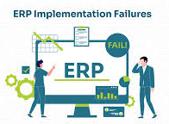
ERP Failure
Failures in implementing new ERP systems can reach millions of dollars.
As a result of the complexity of installing new systems, development costs can quickly rise, and if there are problems with the implementation, the money is lost, and more funds need to be spent to repair the damage.

Slide 27
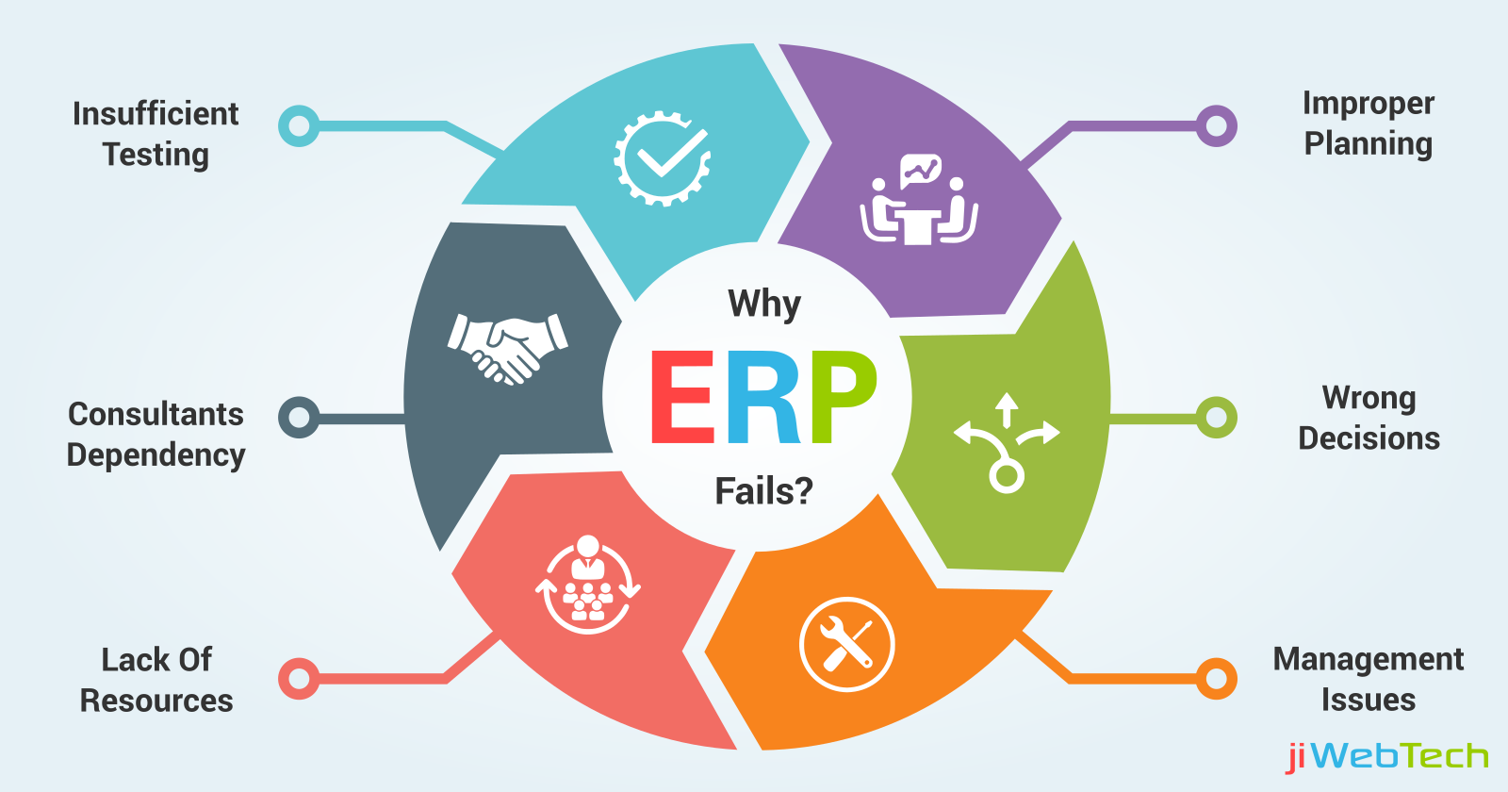
ERP Failure Factors

Slide 28
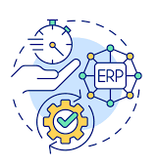
Insufficient Testing
Explanation:
Not enough testing before going live can result in undetected bugs or configuration issues.
Example:
Company skips UAT and miscalculates stock post-launch.

Slide 29

Improper Planning
Explanation:
Failure to define goals, scope, budget, and timelines clearly from the start.
Example:
University starts ERP implementation without proper planning and overspends.

Slide 30

Wrong Decisions
Explanation:
Wrong decisions during ERP implementation refer to strategic or operational choices that negatively affect the project's success. These decisions may stem from poor judgment, lack of ERP knowledge, inadequate stakeholder involvement, or failure to align the ERP system with the organization’s actual needs.
Example:
Retail chain company chooses a manufacturing ERP, causing inefficiencies.
Choosing the cheapest option without evaluating future needs

Slide 31

Management Issues
Explanation:
Lack of leadership support or unclear responsibilities.
Example:
Leadership changes mid-project and fails to prioritize ERP.

Slide 32

Lack of Resources
Explanation:
Not enough time, staff, or budget to complete the project properly.
Example:
IT staff is stretched thin, delaying the ERP project.
Notes:
Depending on the size and scope of a business, ERP implementations can take months or years to complete. Knowing that core implementation teams will need to dedicate at least half of their time to the project and that staff might come and go during the implementation process, businesses must plan and ensure that they have enough resources to bring their ERP vision to life on time without affecting their other business objectives, such as meeting seasonal sales targets. Businesses should also factor training times into their resource planning, as different employees and teams will come on board at different stages of the ERP implementation.

Slide 33

Consultants Dependency
Explanation:
Over-relying on external consultants without building internal knowledge.
Example:
Consultants leave and no internal staff can maintain system.

Slide 34

Insufficient Training
Explanation:
Users (employees) don’t understand how to use the ERP system effectively.
Example:
Employees revert to manual spreadsheets due to poor training.

Slide 35

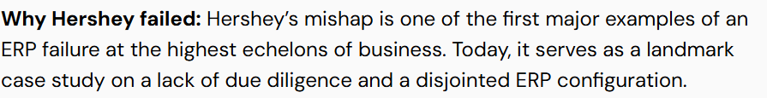
ERP Failure Factors – Case Study
In the late nineties, Hershey discovered their legacy systems had a high risk of being affected by the Millennium Bug.
Instead of spending lots of money to fix the date-related issues, they decided to replace their ERP. They chose to implement three separate ERP solutions from SAP, Siebel, and Manugistics, which proved too complicated and disjointed for the company to use properly, and their self-imposed deadlines proved to be unrealistic.
Hershey would go on to lose more than $100 million in orders for products they had in stock and experienced an 8% drop in their stock price in one day.
The company eventually recovered a year later and completed full integration of an SAP ERP in 2002.

Slide 36

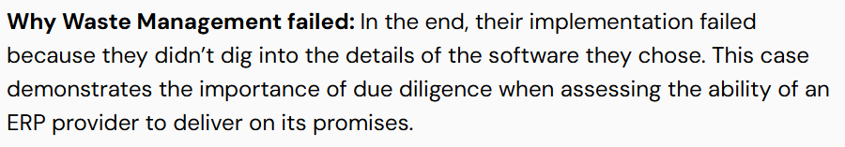
ERP Failure Factors – Case Study
A lawsuit filed by Waste Management against SAP in 2008 brought the company to the public’s attention. In the lawsuit, SAP was accused of providing a software mockup that was modified to appear as if it was fully functional.
Initially, Waste Management claimed losses of $100 million from both implementation costs and loss of revenue. They later bumped that number up to $500 million. Both parties would settle out of court two years after the initial lawsuit.

Slide 37

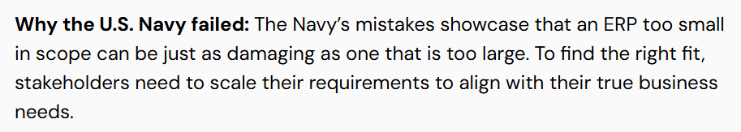
ERP Failure Factors – Case Study
From 1998 to 2005, the U.S. Navy tried — and failed—to launch a proper ERP system on four separate occasions.
A report from the Government Accountability Office stated the small scope and redundancies of the ERP systems did not fulfill Navy requirements.
The cost of the four projects was gigantic — to the tune of $1 billion in total.
Ultimately, the Navy worked with SAP again to develop a consolidated system — three of the four ERPs were discontinued and replaced with a single SAP application.

Slide 38

ERP Failure Factors – Case Study
Around the turn of the 21st century, Nike was the premier name in the sneaker industry.
To secure their market dominance, the company worked with i2 Technologies to develop an ERP solution for the company’s demand planning processes.
However, Nike’s leadership rushed the timeframe, and their new ERP went online with major bugs that tanked the company’s ability to distribute their flagship product at the time — Air Jordans.
The result was a total loss of $500 million dollars from both lost sales and project costs, as well as several lawsuits resulting from unfulfilled orders. They adopted a more robust SAP ERP in 2003.

Slide 39
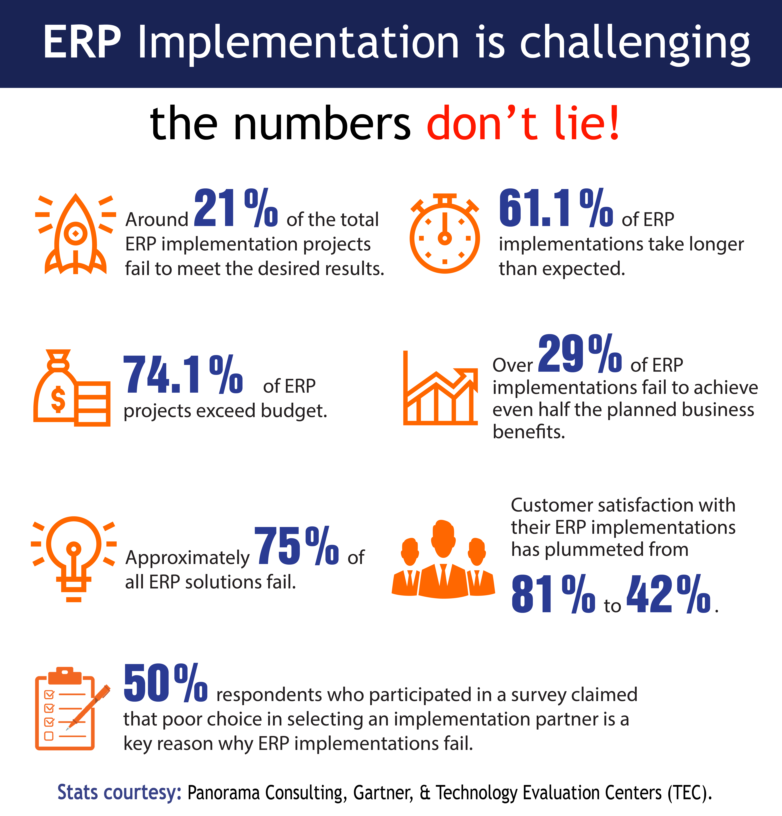

Slide 40

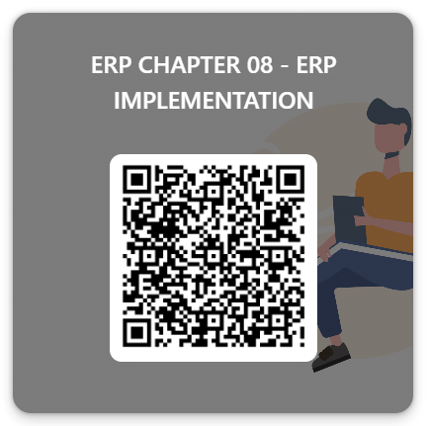

ERP
quiz
ACTIVITY

Slide 41
Summary
ERP implementation projects are significant undertakings that require careful planning and monitoring. By establishing and tracking the right KPIs and adhering to critical success factors, organizations can increase their chances of a successful ERP implementation. Remember that ERP implementation is not just about technology; it's a strategic initiative that can transform how a business operates, making it imperative to get it right.
ERP (Enterprise Resource Planning) failures are a significant concern in digital transformation, with high failure rates often stemming from a variety of factors. Common causes include poorly defined system requirements, lack of executive buy-in, inadequate training, insufficient testing, and poor project management. These failures can lead to substantial financial losses, operational disruptions, and reputational damage.

